Slide 1
Cross-Platform Mobile Application Development with Xamarin
Module 3, Lesson 11:
Debugging and Testing Xamarin Apps
Notes:
Images and excerpts from Xamarin Mobile Application Development by Dan Hermes, published by Apress
http://www.mobilecsharpcafe.com/xamarin-book/

Slide 2
Topics
Debugging Xamarin applications
Testing Xamarin applications
Xamarin Sketches
Xamarin Test Cloud

Slide 3
Objectives
By the end of this lesson you should know:
The importance of testing and debugging code
Cross-platform application testing and debugging nuances
How to increase productivity while testing and debugging

Slide 4
Importance of Debugging
You want to be able to identify and fix code issues quickly
Learning how to efficiently debug improves code quality
Results in better programming habits
Set and adhere to best practices
Reduce bugs in the future
Notes:
References:
Debugging overview: https://msdn.microsoft.com/en-us/library/sc65sadd.aspx

Slide 5
Importance of Testing
Ensure that the software fulfills requirements
Ensure that the software meets quality expectations
Verifying that edge cases are handled appropriately
No unexpected behavior observed in production
Notes:
Notes:
“Production” refers to code that has been released as a finished product to the end consumer
You don’t want bugs to be found by the user. You want to anticipate and prevent bugs as much as possible
References:
Testing overview: https://msdn.microsoft.com/en-us/library/cc188960.aspx

Slide 6
Cross-Platform Nuances
Debugging
Testing
What causes a bug in one platform may not cause it in another
Don’t assume code works on all target platforms, check
Make sure fixing one bug doesn’t create another
Debugging separate device or emulator/simulator
Adds layers of complexity
Interpretation among environments
Not as performant
May need separate test projects per platform
Must account for many devices
A test may pass for one device but fail for another
Make sure that fixing a test for one device does not break it for another
Notes:
Notes:
Debugging
For every platform that is to be targeted by the finished product (iOS, Android, Windows, etc.), don’t assume that working code will function the same in another platform
If a bug is fixed in a platform, make sure to retest the other platforms tested to ensure that no new bugs were introduced for those platforms
When debugging on a device or when debugging a simulator or emulator, you are not debugging on the native device where the code is being run and compiled. This means that some kind of interpretation or handling must be done between the devices. This adds complexity and may reduce performance
Testing:
Depending on the framework, you may need a separate test project for each target platform
This lowers amount of reusable test code
Tests must cover multiple devices, sometimes many, many devices
Some devices may have many variants. All target devices must be tested

Slide 7
Debugging Xamarin Applications

Slide 8

How Debugging Works in Xamarin
Select Debug => Start Debugging in Visual Studio
Select Run => Start Debugging in Xamarin Studio
Xamarin uses the Mono Soft Debugger
Abstracts device differences, unifies debugging interface
Not a separate process
Debugging code built into application
Application is larger, slower when debugging
Notes:
Notes:
From the top menu bar in Visual Studio, click Debug and then Start Debugging from the submenu
From the top menu bar in Xamarin Studio, click Debug and then Start Debugging from the submenu
Hitting F5 in both Visual Studio and Xamarin Studio will start the application in debug mode
Hitting the play button in both Visual Studio and Xamarin Studio will start the application in debug mode
Most debugging is wholly separate from the application in that it more or less pays attention to the application for errors and points to the source code that causes the problem
The Mono Soft Debugger is compiled into the application and run in the runtime. This is done to abstract the differences between the devices that Xamarin supports
References:
Further reading on the Mono Soft Debugger: http://www.mono-project.com/docs/advanced/runtime/docs/soft-debugger/
Image source: https://developer.xamarin.com/guides/cross-platform/xamarin-studio/debugging_with_xamarin/Images/image_0.png

Slide 9
Breakpoints in Xamarin
A Breakpoint Indicates a line of code you want to examine
Stops the execution of the program when it reaches the indicated line of code
Hover over variables to see values
View watch or local debug windows to examine code
Notes:
Notes:
How To:
Click margin to left of line of code you want to examine
Hit F9 while cursor is on line of code you want to examine
Hit F10 to step over a line on which the application is paused
Hit F11 to step into a line on which the application is paused
Hitting F5 while code is paused will resume execution
Clicking the left margin or hitting F9 work the same in both Visual Studio and Xamarin Studio
F10 and F11 commands work in both Visual Studio and Xamarin Studio. There are menu options to do the same things. The vast majority of developers use F10 and F11
To “step over” a line of code means to let the application execute that line of code and then pause the execution of code afterwards
To “step into” a line of code means that the paused code progresses into the first line of code of the first method called in that line of code, if any, and then pauses again
Hitting F5 while code is paused will resume execution until the next breakpoint or an error is encountered or the code completes execution

Slide 10
Testing Xamarin Applications

Slide 11
Unit Tests vs UI Acceptance Tests
Unit Tests
UI Tests
Aim to test small pieces of logic
e.g. a method or part of a method
Can have one unit test project for shared code project
Must have a separate unit test project per device project
Aim to test a user scenario via the user interface
Can be expensive
Can be time-consuming
Manual UI acceptance tests:
Tester manually tests acceptance criteria for a user scenario
Xamarin Test Cloud can be used to automate UI tests
Notes:
Notes:
Unit testing tests small pieces of logic, like a method or a part of a method
UI acceptance tests are when there is interaction with the app to carry out a scenario an end user might want to complete
Frequently, acceptance tests are done manually. In these cases, it can take a lot of time and cost a lot of money. Especially when these tests need to be performed on many different devices
Unit Tests:
If the code in a project is cross-platform, there is only a need for one test project
If there is a project just for a specific device that needs unit tests, there needs to be a separate unit test project for that device
UI Acceptance Tests:
Manual UI acceptance tests will work just fine
Xamarin Test Cloud will be explained in the subsequent slides
References:
More on unit testing: https://msdn.microsoft.com/en-us/library/aa292197(v=vs.71).aspx
More on UI acceptance testing: https://msdn.microsoft.com/en-us/library/ff649646.aspx

Slide 12
Xamarin Test Cloud
Automatable method of performing UI acceptance testing
Can perform UI acceptance tests on hundreds of devices
Cloud-based
Notes:
Notes:
Because these tests are cloud based, there is no need to obtain/maintain devices
References:
Xamarin Test Cloud overview: https://developer.xamarin.com/guides/testcloud/introduction-to-test-cloud/

Slide 13
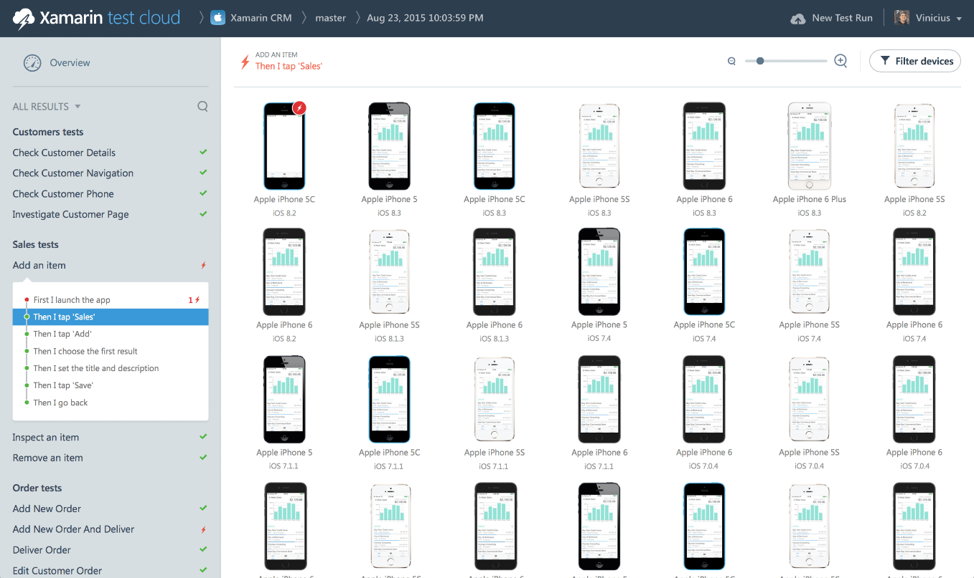
Xamarin Test Cloud
Notes:
References:
Image courtesy of Xamarin

Slide 14
Xamarin.UITest
Framework for building UI tests in C# using Nunit
Consumed by Xamarin Test Cloud
Provides APIs to carry out UI interactions
E.g. app.Tap(c=>c.Button(“Submit"));
Carry out one or more UI interactions, test results
Notes:
Notes:
NUnit is a very popular unit test framework for .NET applications
References:
Background on NUnit: http://www.nunit.org/

Slide 15
Xamarin Test Cloud Agent
HTTP server
Embedded in iOS apps
Separate app installed alongside Android apps
Loads Xamarin.UITest tests
Direct actions specified in tests to execute on device
Notes:
Notes:
The Xamarin Test Cloud Agent reads the Xamarin.UITest tests and uses them to determine what actions to carry out on the device

Slide 16
Adding Project to Xamarin Test Cloud
Must have a team with a user to which to add projects
Start out with a team and a project
Automatically generated upon account creation
Go to account settings in drop down by your name to view:
teams
apps
API key
Notes:
Notes:
Team:
a group of people, which could include just one person

Slide 17
Using Xamarin Test Cloud
Select “New Test Run” in top right
Select target project
Select target devices
Set test run metadata
Upload Xamarin.UITest tests using provided command line input
Notes:
Notes:
You may have many projects. One must be selected
There are hundreds of devices from which to choose. Xamarin Test Cloud provides selectors to help find your target device. These selectors narrow down and/or sort devices based on many factors, including market share, name, OS version and form factor
The metadata available include “test series,” which is the environment (development vs. production, for example), “system language,” “parallelization,” to run the tests in parallel, and “execution priority,” which sets the priority for when to execute these tests. App developers are charged for high priority tests
The instructions for uploading Xamarin.UITest tests amount to copy-pasting a command into a command prompt and adding your email address and API key in designated locations of the copy-pasted command
References:
Tutorial on running tests on Xamarin Test Cloud: https://developer.xamarin.com/guides/testcloud/organizations-and-teams/creating-a-test-run/

Slide 18
Xamarin Sketches
Live coding environment
Executes code on the fly
Test small pieces of code, not entire app
Only on Xamarin Studio for Mac
Notes:
Notes:
Live coding environment can reduce development time
Xamarin Sketches does not load an entire app or solution, etc. It is meant as a sandbox to quickly test an algorithm or UI control’s look and feel, etc.
Redeploying an app to a device or even to a simulator or emulator just to test a small change is an extremely time-consuming endeavor. Seeing live updates and loading up small pieces of code can reduce development time
Support in Visual Studio and Xamarin Studio for Windows coming soon

Slide 19
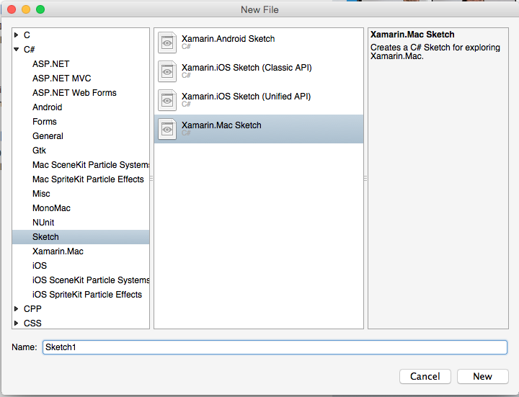
Creating Xamarin Sketches
In Xamarin Studio, File > New > File…
Select C# => Sketch in new file dialog (on the right)
Choose the device you want to target
Give sketch a name
Notes:
References:
Image source: https://developer.xamarin.com/guides/cross-platform/sketches/introduction/Images/Create002.png

Slide 20
Using Xamarin Sketches
There are three panels in a Xamarin Sketch
Panel | Description
Code Editor | Write code to be evaluated on the fly
Evaluation Results | Displays the result of each line
Output and Analysis | Device type selection (launches appropriate simulator/emulator) Any console output
Notes:
Notes:
There are three panels in a Xamarin Sketch: code editor, evaluation results and output & analysis
Evaluation results displays results of each line. For example, if a line says “var a = 1;” the evaluation results have the value “1” for that line. Complex types can be examined by hovering over them and drilling into their attributes

Slide 21
Summary
In this lesson, you have learned:
The importance of testing and debugging code
Cross-platform application testing and debugging nuances
How to increase productivity while testing and debugging

